Slide 1


Introduction to BlockChain and CryptoCurrency
Lecture # 2: Chapter 1: Introduction to Cryptography & Cryptocurrencies

Slide 2
Overview
Cryptographic Hash Functions
Public Key Crypto
RSA vs ECC
Digital Signatures
Hash Pointers
Merkle Trees
Block Structure and Chains

Slide 3
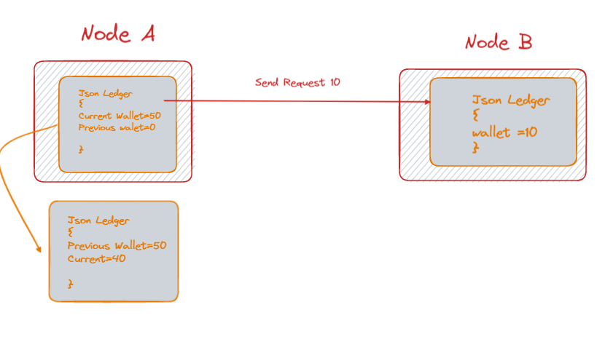
Lab -1 Working Explanation

Slide 4
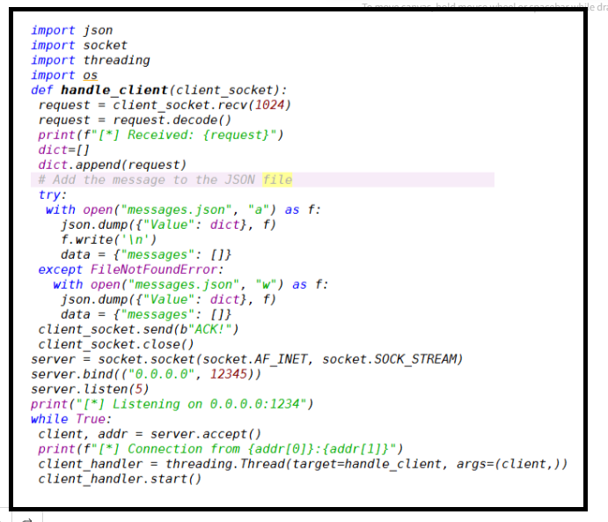
Server Side Code

Slide 5
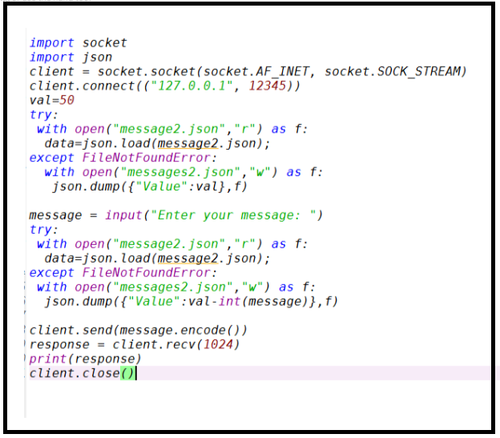
Client Side Code

Slide 6
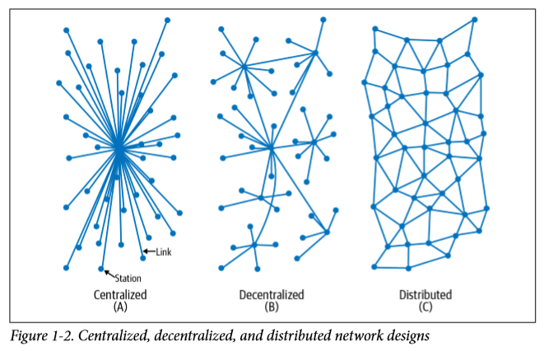
Distributed Versus Centralized Versus Decentralized

Slide 7
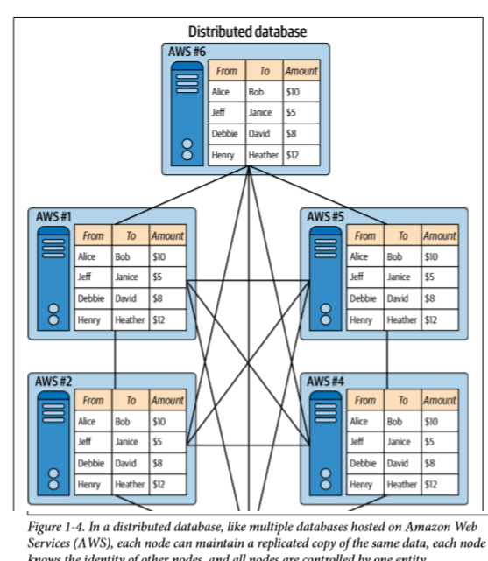
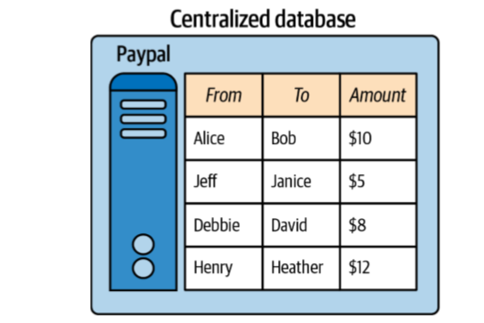

Slide 8
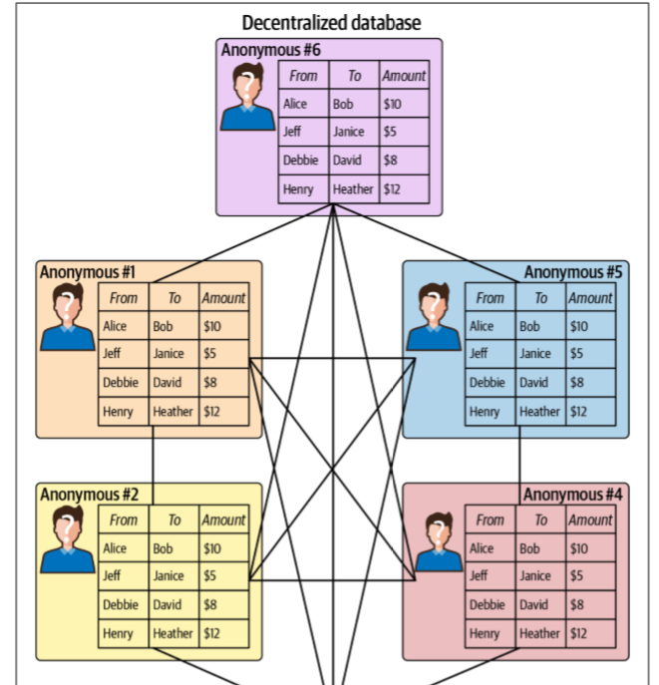

Slide 9
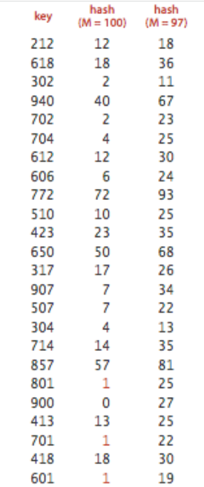
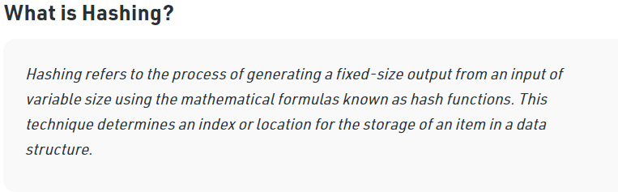
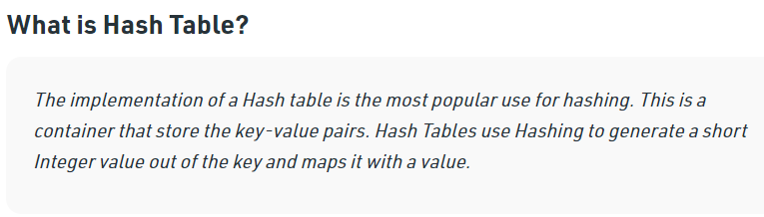

Slide 10
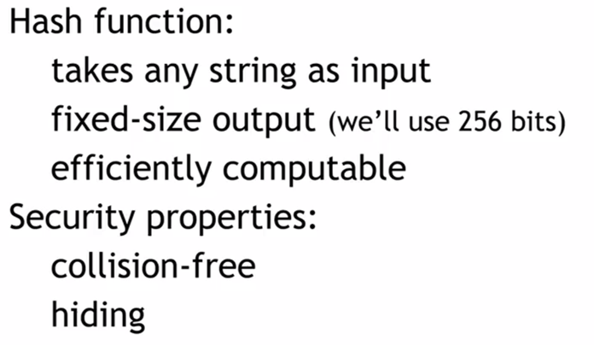

Slide 11
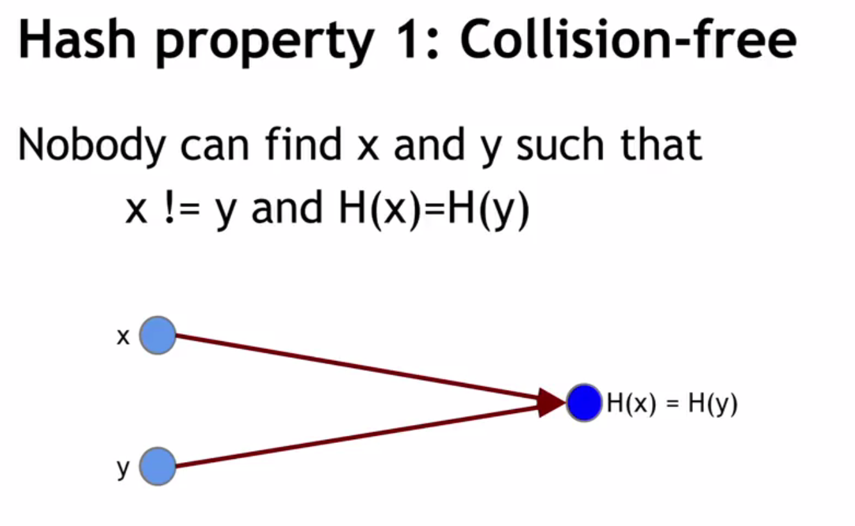
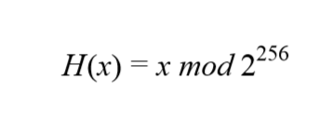

Slide 12
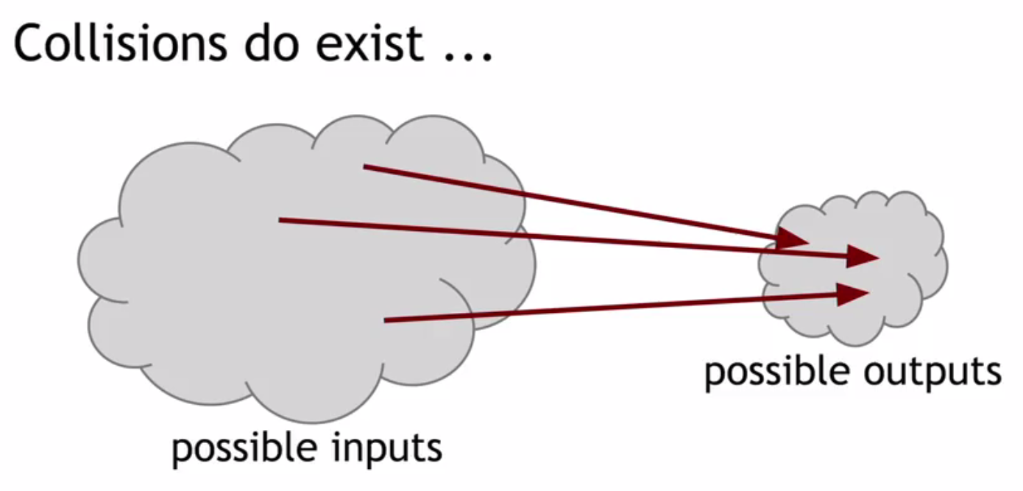

Slide 13
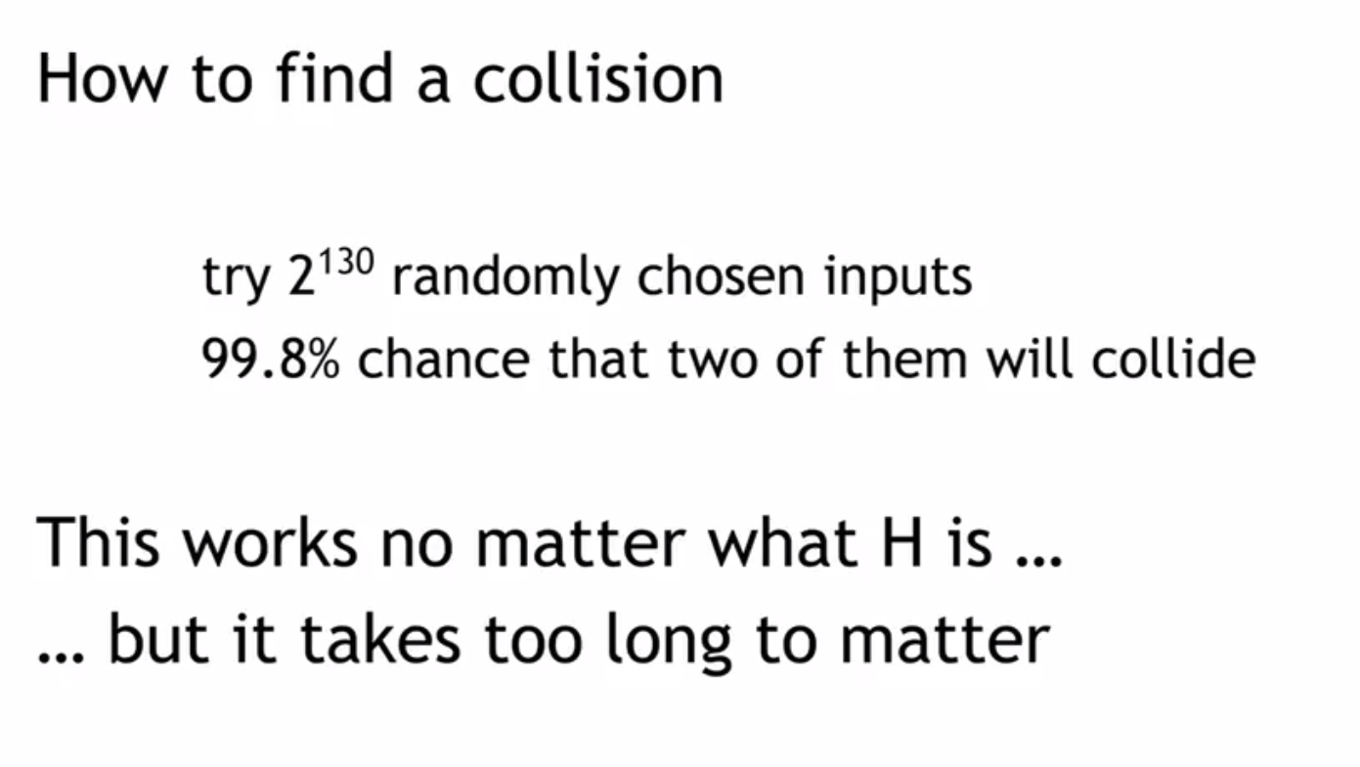

Slide 14
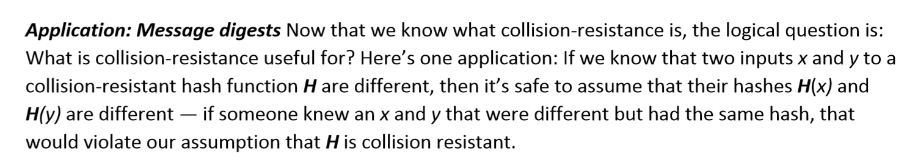

Slide 15
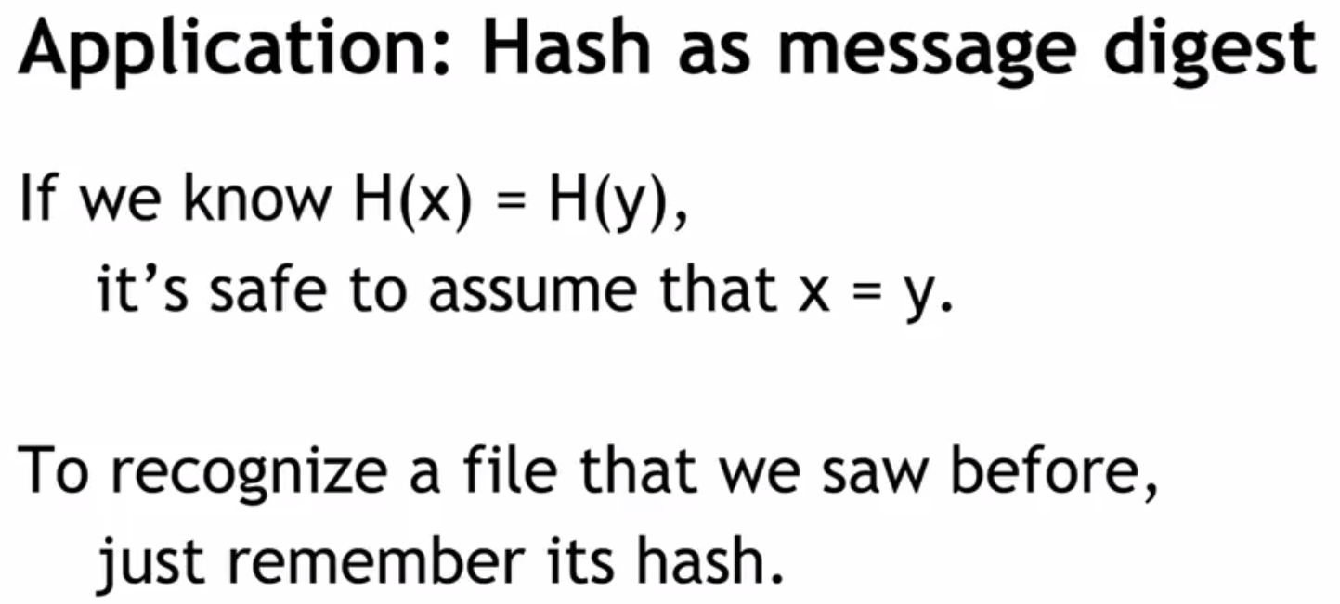

Slide 16
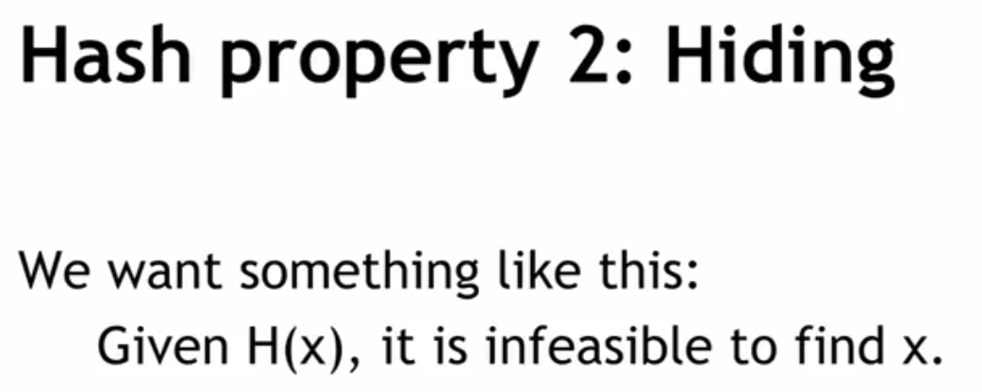
import hashlib
a_string = 'Shahbaz'
hashed_string = hashlib.sha256(a_string.encode('utf-8')).hexdigest()
print(hashed_string)
Output :3fe38d3b3468a87ce5679aaba200d175d8cb5a409011e2b030ff52353e55058d

Slide 17
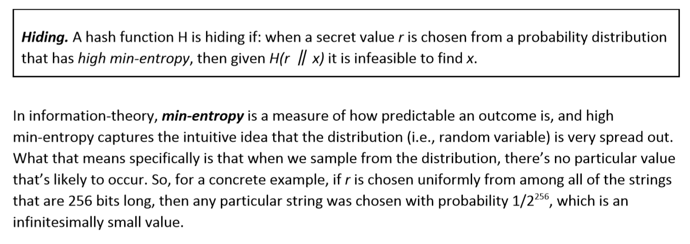

Slide 18
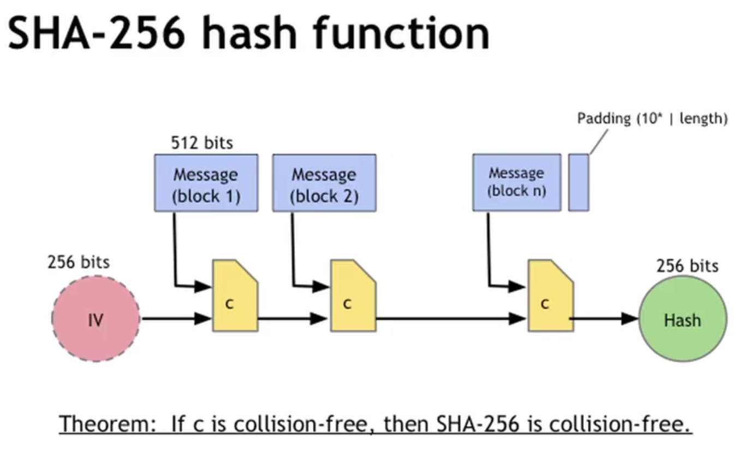

Slide 19
Hash Pointer and Data Structures

Slide 20
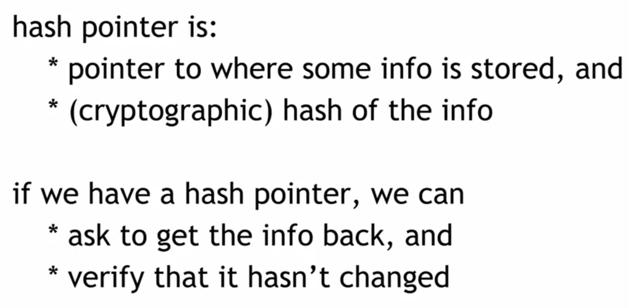

Slide 21
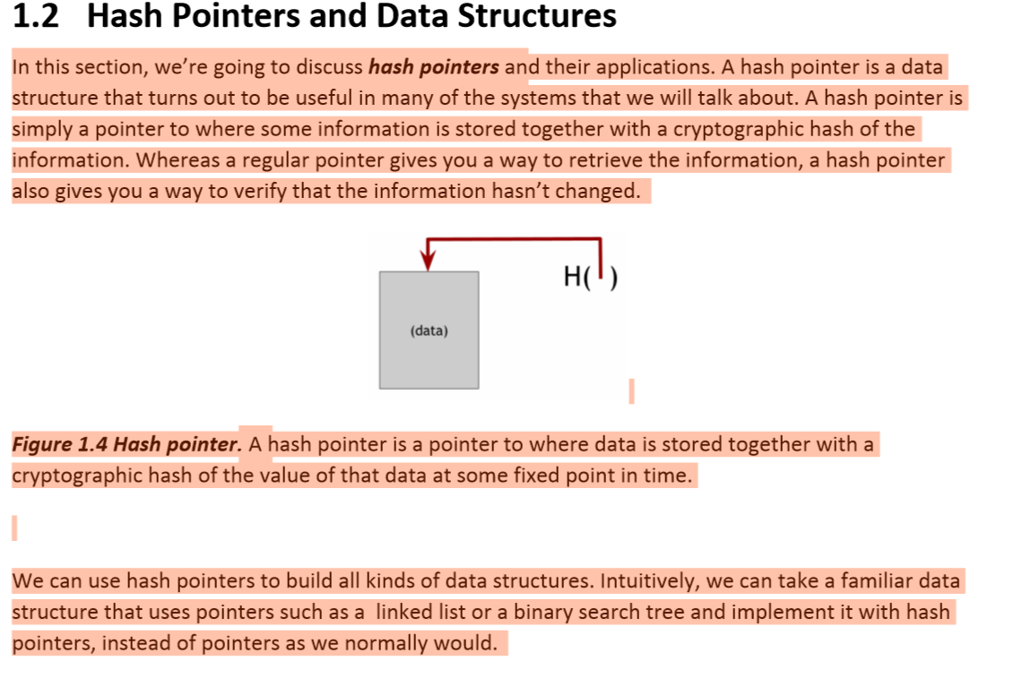
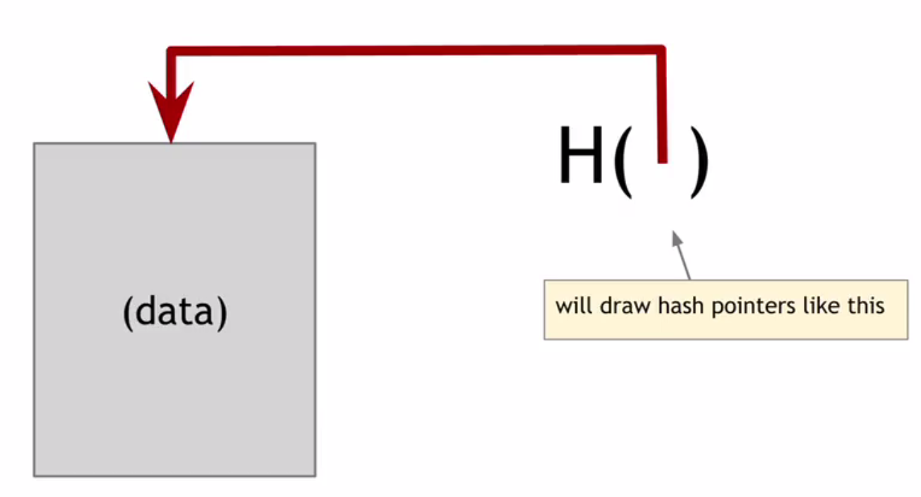

Slide 22
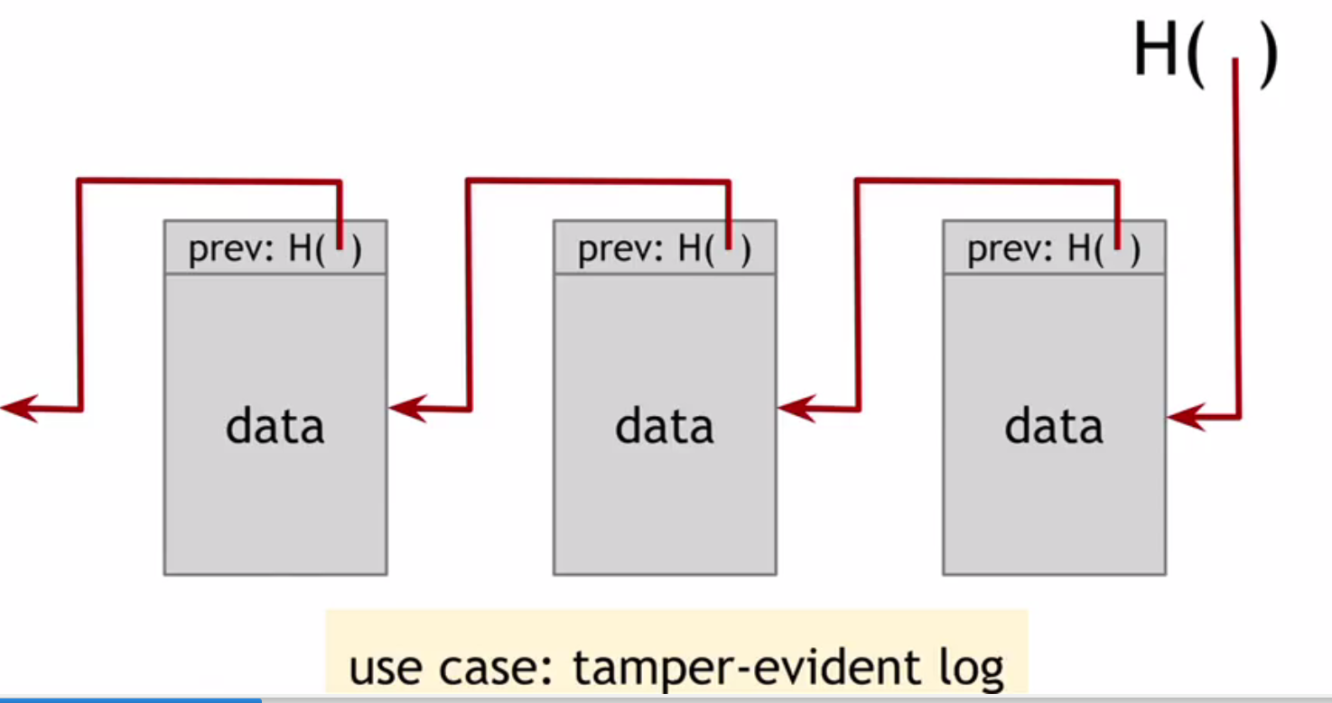

Slide 23
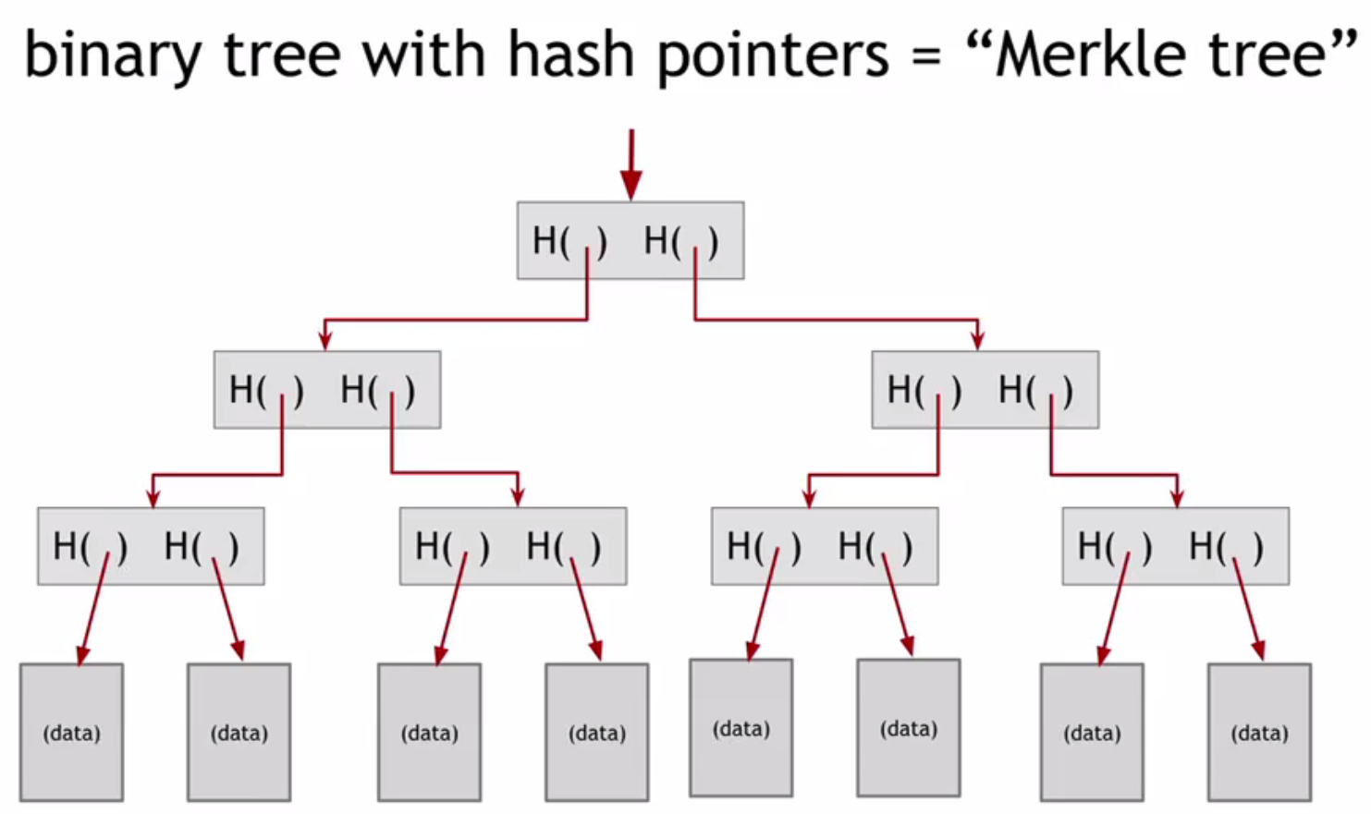

Slide 24
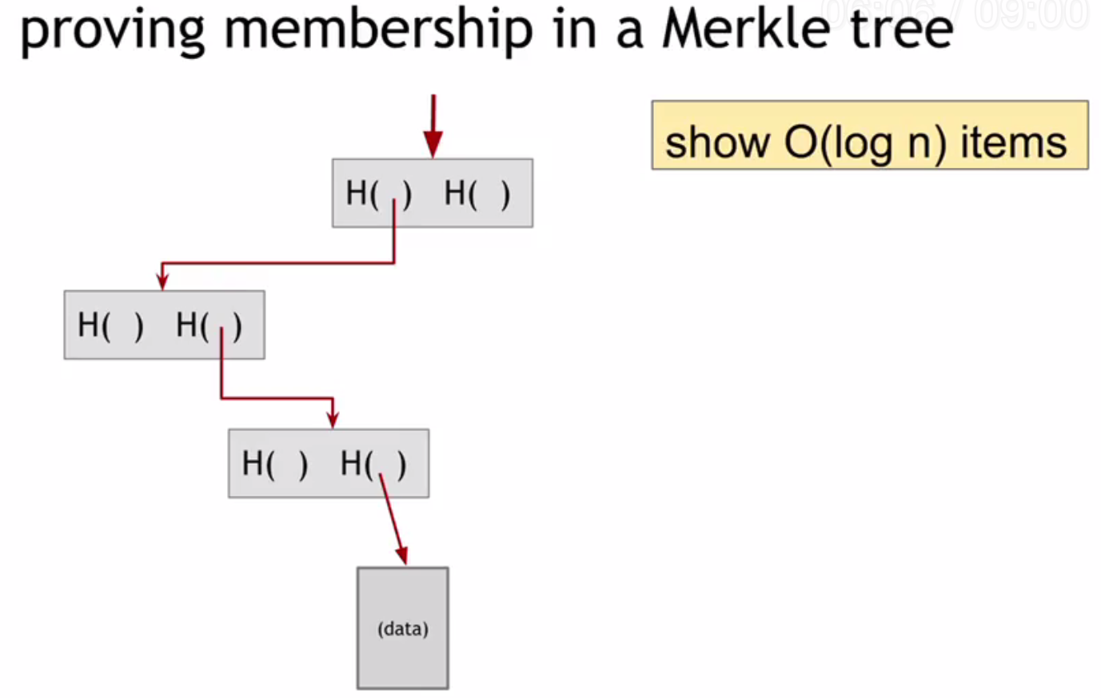

Slide 25
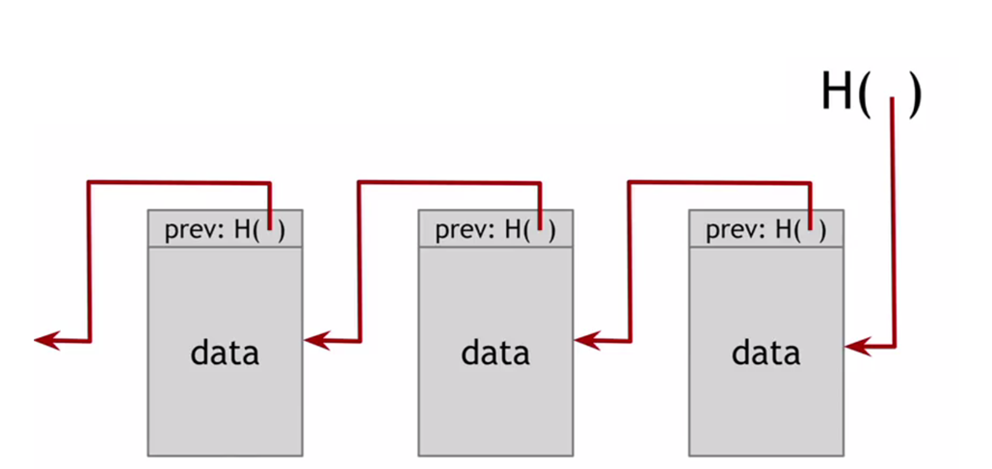
Lab Discussion

Slide 26
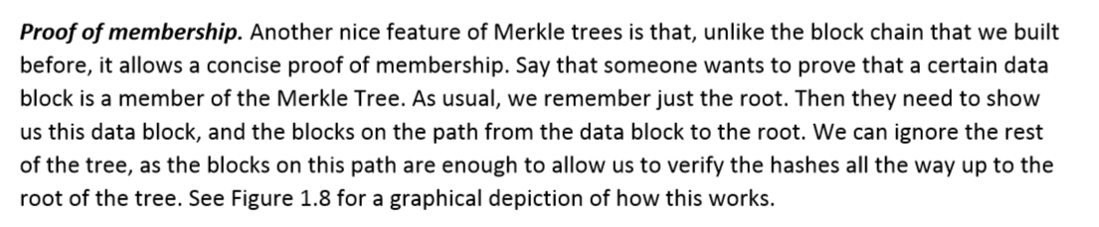

Slide 27
Introduction to BlockChain and CryptoCurrency
Lecture # 3: Chapter 1: Introduction to Cryptography & Cryptocurrencies

Slide 28
Public Key Cryptography

Slide 29
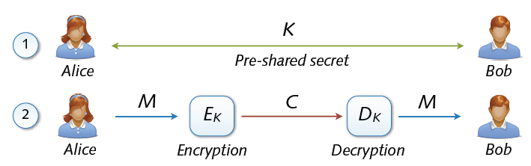
Symmetric cryptosystems
Precondition: secure exchange of keys in advance
Paradox situation at a first glance
secure communication depends on secure key exchange

Slide 30
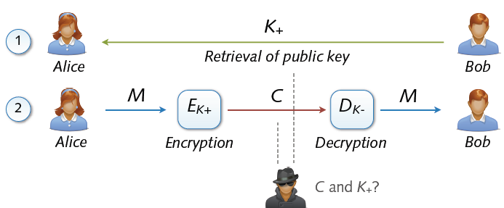
Asymmetric Cryptosystem
Asymmetric cryptosystems
Asymmetric encryption and decryption
K+ (pk) = public key of Bob K– (sk) = secret key of Bob
No secure key exchange necessary

Slide 31
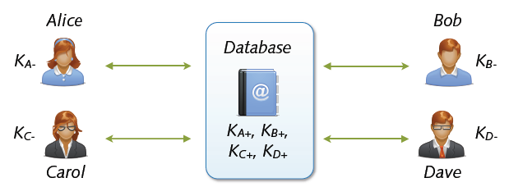
Key Exchange with Public Keys
Scalable communication with multiple parties
Linear number of exchanges: n parties → n public keys
Real-world systems with millions of keys (e.g. PGP)
... for the moment everything is fine

Slide 32
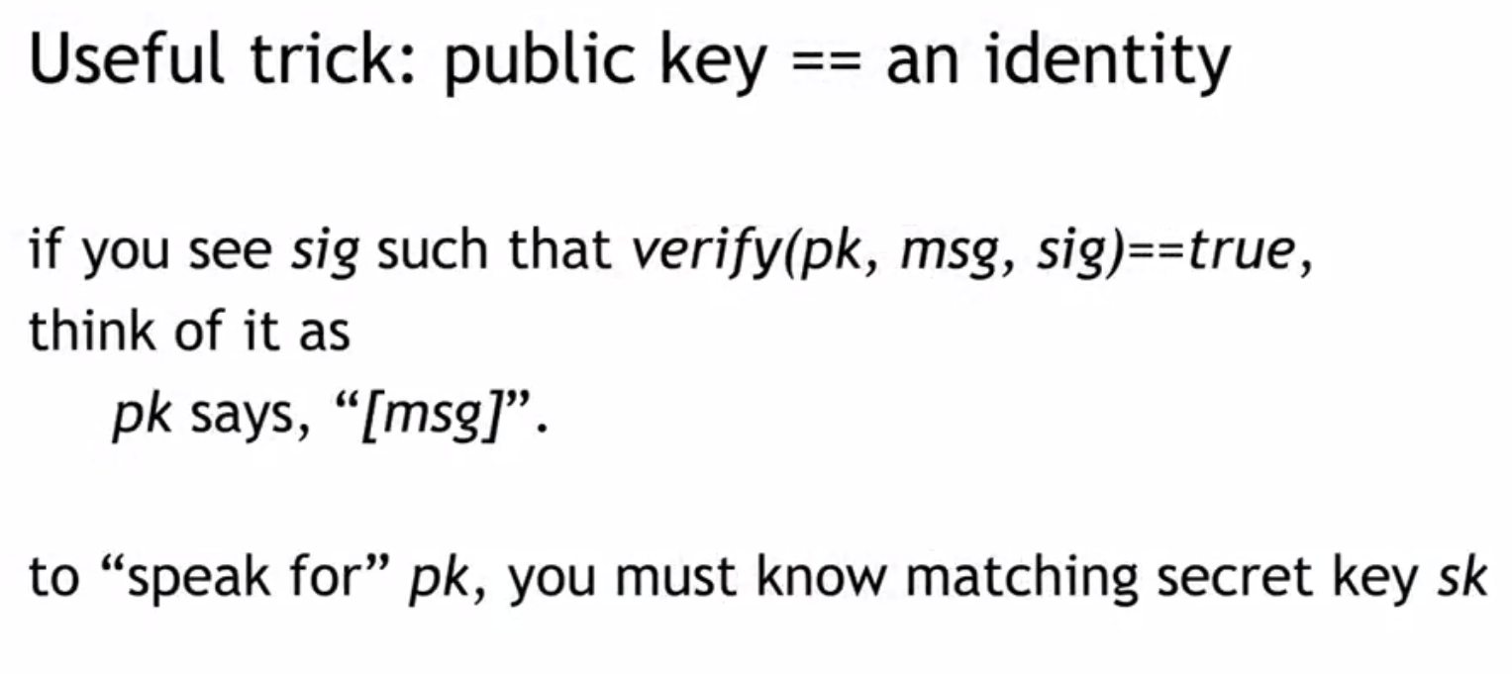

Slide 33
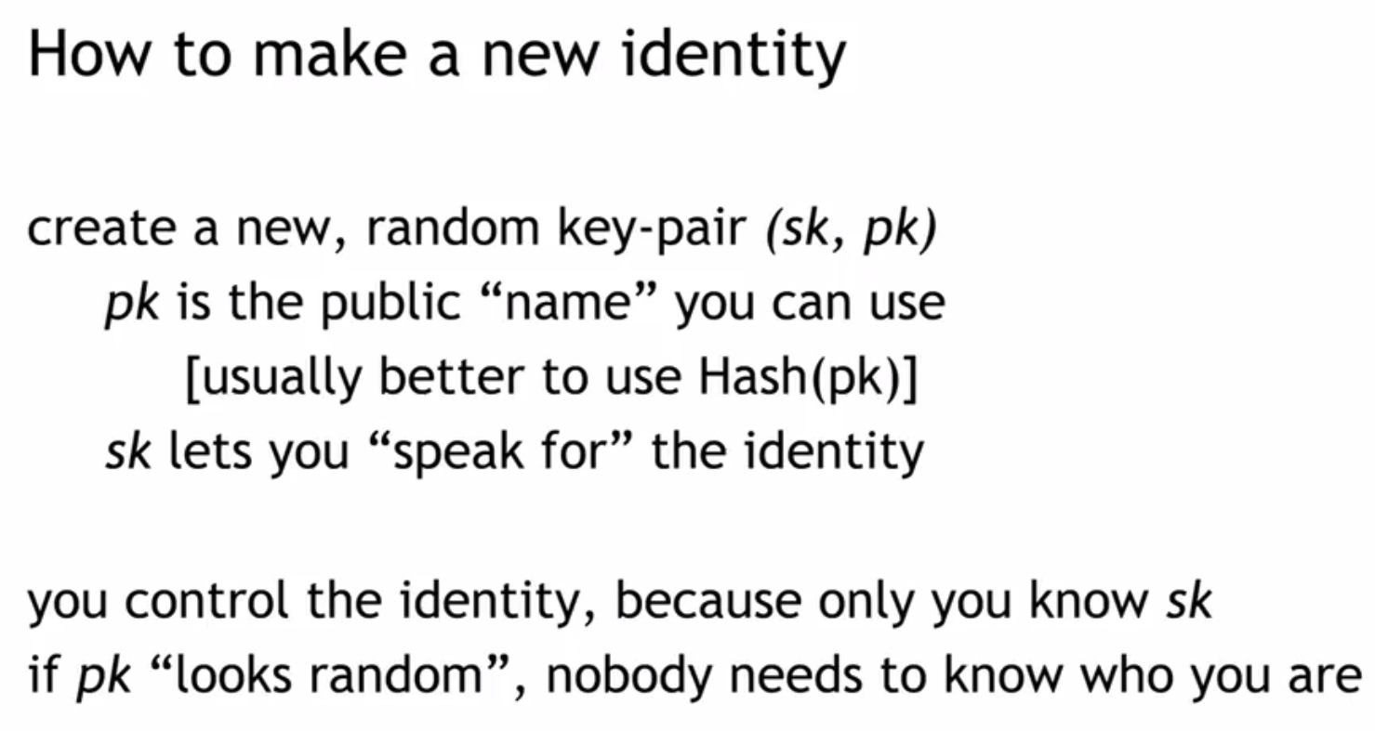

Slide 34
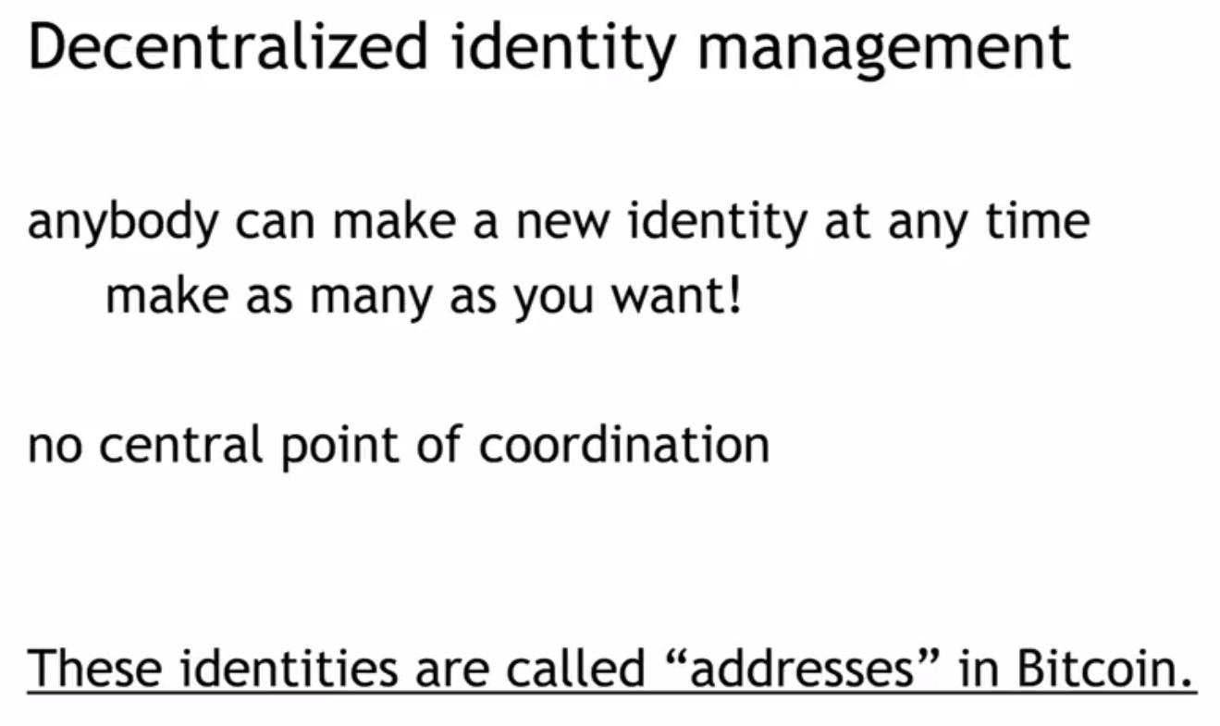

Slide 35
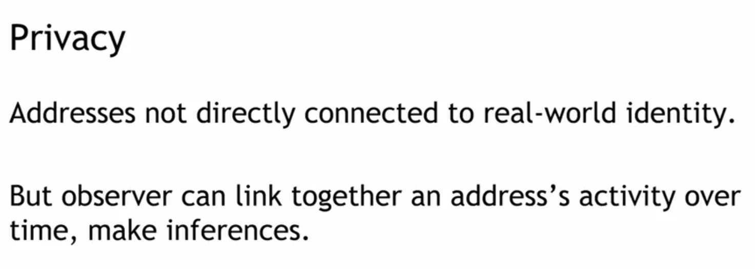

Slide 36
Block Structure and BlockChains

Slide 37
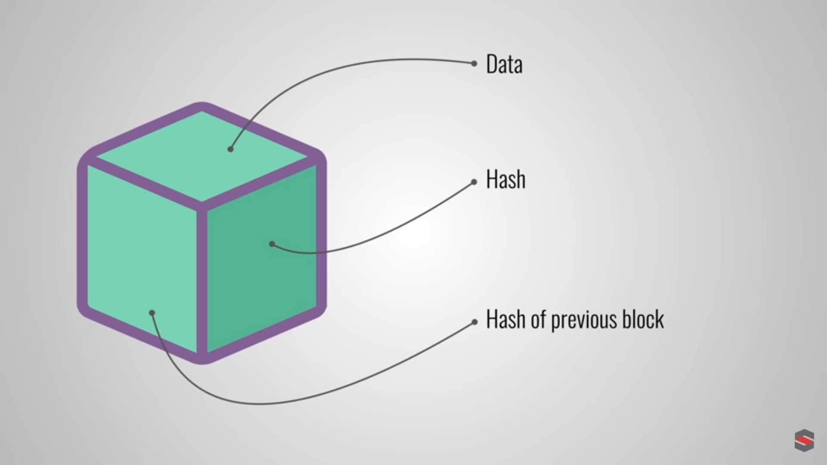

Slide 38
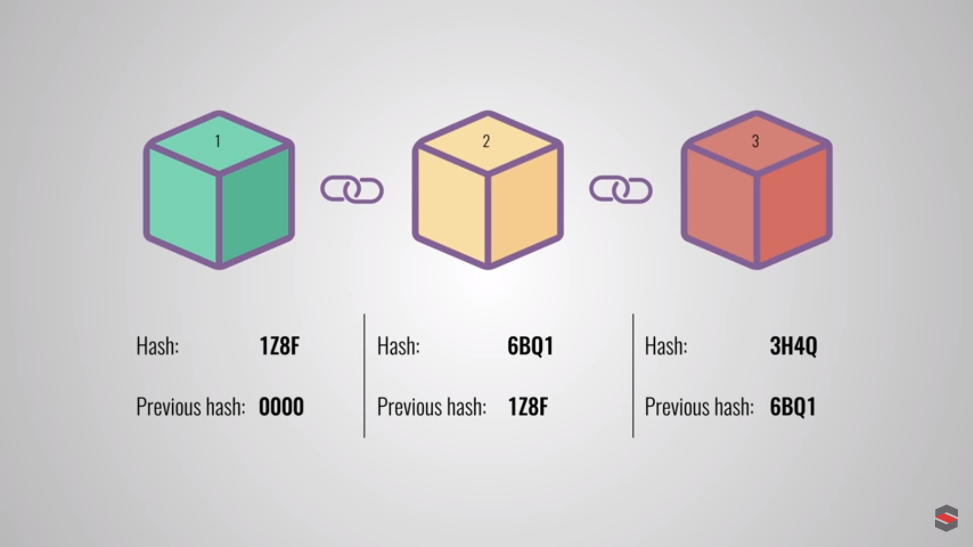

Slide 39
Digital Signatures

Slide 40
Digital Signature
Authentication and Non-Repudiation
Gives a recipient reason to believe that the message was created by a known sender such that they cannot deny sending it
Integrity
The message was not altered in transit
Notes:
Non-repudiation refers to a state of affairs where the purported maker of a statement will not be able to successfully challenge the validity of the statement or contract

Slide 41
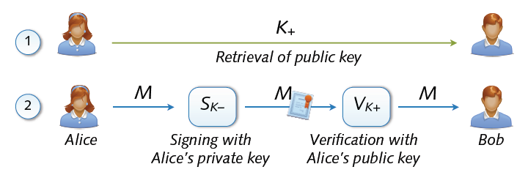
Digital Signature
Digital signing: reverse application of public-key system
Signing = encryption with private key
Verification = decryption with public key

Slide 42
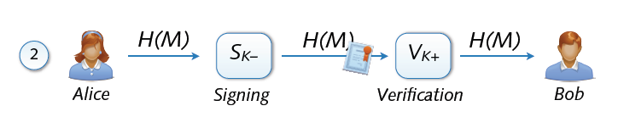
Signing and Hashing
Encryption and decryption of large messages inefficient
Signing of hash H(M) instead of message M
Verification of message M using signed hash H(M)
One-way property: hard to find M’ with H(M’) = H(M)
Support for signing emails, images, videos, ...

Slide 43
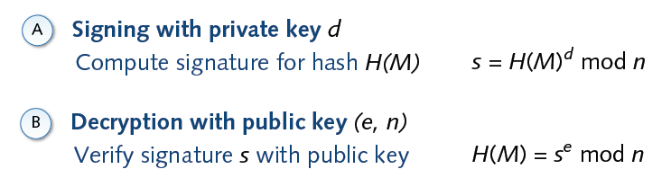
Signature and RSA

Slide 44
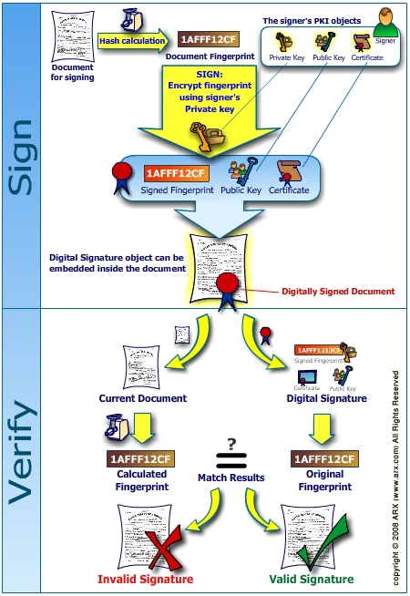
`

Slide 45
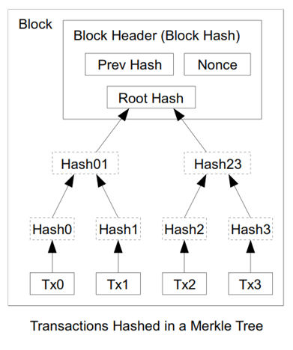

Slide 46
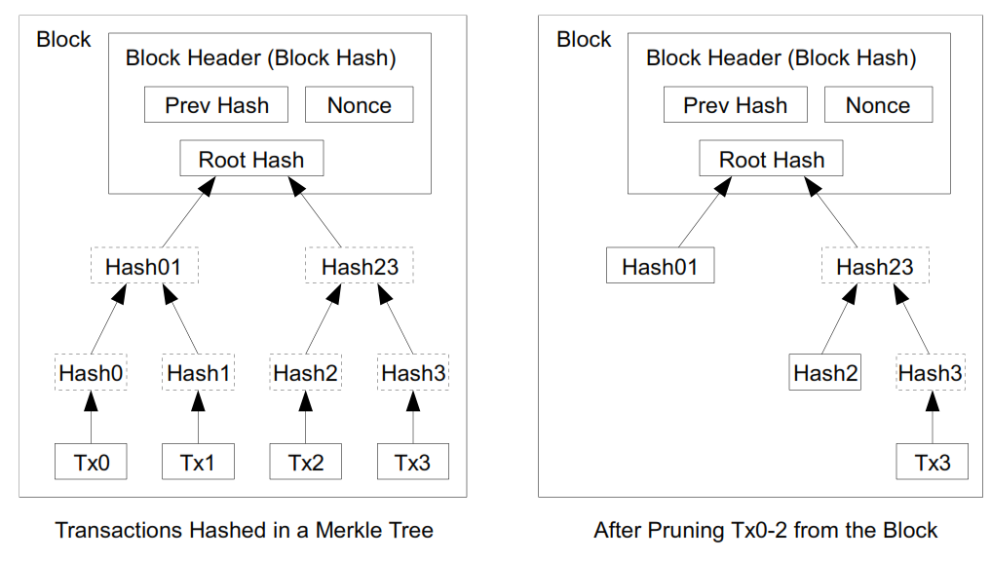
The spent transactions before it can be discarded to save disk space.
A block header with no transactions would be about 80 bytes. If we suppose blocks are generated every 10 minutes, 80 bytes * 6 * 24 * 365 = 4.2MB per year [Theoratically]

Slide 47
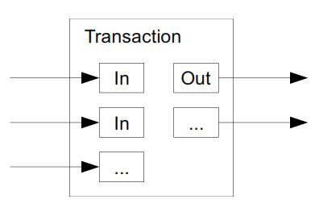

Slide 48
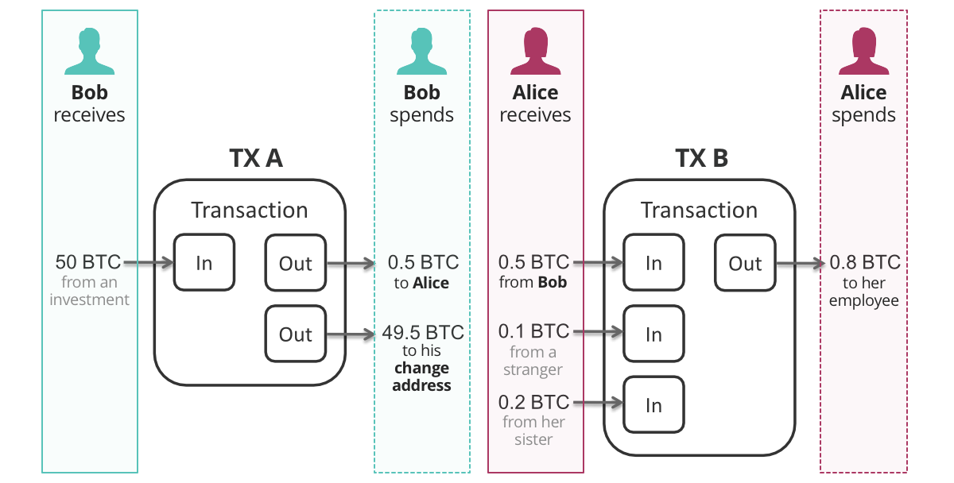

Slide 49
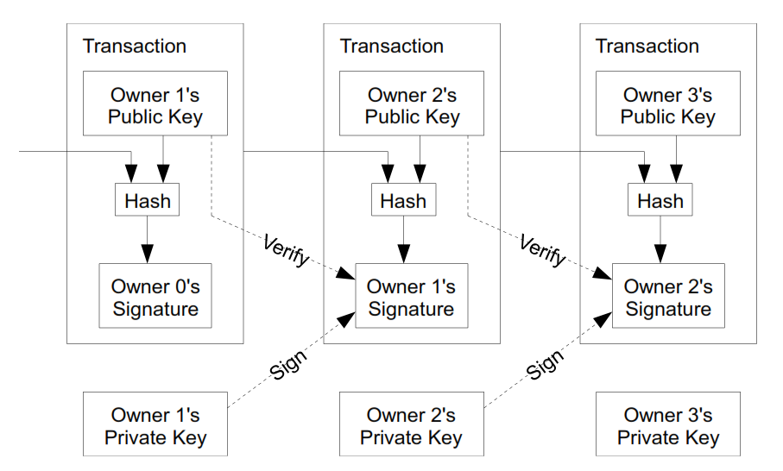

Slide 50
Acknowledgements
Material in this lecture are taken from the slides prepared by:
Prof. Dr. Konrad Rieck (Uni-Göttingen)
Satoshi Nakamoto, Bitcoin: A Peer-to-Peer Electronic Cash System, 2008
https://twitter.com/savjee
Dan Finlay https://github.com/MetaMask/IPFS-Ethereum-Hackathon
Edureka.com
Prof. Arvind Narayanan — Princeton University

